Slide 1
电磁学(Electromagnetism)
The combination of electrical and magnetic phenomena

Slide 2
物理学的第二次大综合
库仑定律： 电荷与电荷间的相互作用
奥斯特的发现： 电流的磁效应，安培发现电流与电流
间的相互作用规律.
法拉第的电磁感应定律：电磁一体
麦克斯韦电磁场统一理论（19世纪中叶）
赫兹在实验中证实电磁波的存在，光是电磁波.
技术上的重要意义：发电机、电动机、无线电技术等.

Slide 3
Chapter 19 Electric Charge and Electric Field
Static Electricity; Electric Charge and Its Conservation; Insulators and Conductors; Induced Charge
Coulomb’s Law
The Electric Field and its Calculations
Electric Field and Conductors
Electric Dipoles

Slide 4
New Words and Expressions
static charge 静电荷
quantized 量子化的
elementary charge 基本电荷
conductor 导体
insulator 绝缘体
induce 感应
Coulomb 库仑
point charge 点电荷
permittivity of free space 真空电容率
electric field 静电场
test charge 试验电荷
electric dipole 电偶极子

Slide 5
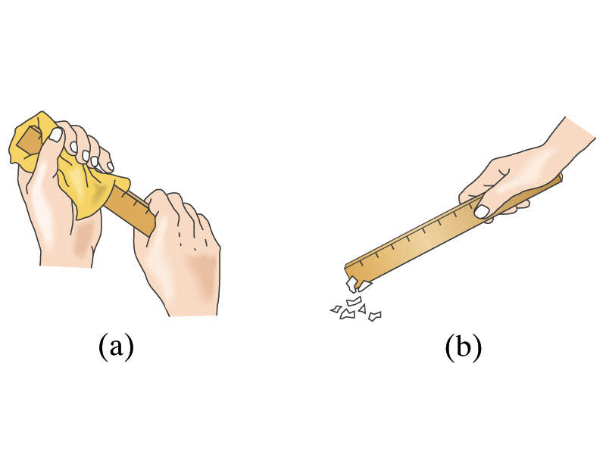
19-1&19-2&19-3&19-4. Electric Charge and Its Conservation; Insulators and conductors; Induced Charge (P456-460)
1 Static electricity
Rub a plastic ruler (a) and bring it close (b) to some tiny pieces of paper.

Slide 6
2. Electric charge (电荷)
It is an intrinsic character of the fundamental particles making up those objects.
一个物体能够吸引轻微的物体，这个物体就带有电荷，也称带电体。
It can be either positive or negative. Charges with the same sign repel each other and charges with opposite signs attract each other. That is: unlike charges attract, like charges repel (同号相斥, 异号相吸). p457

Slide 7
3. Law of conservation of electric charge (p457)
The net amount of electric charge produced in any process is zero.
4. The SI unit of charge is the Coulomb. (p461)
The SI unit of charge is the coulomb (C).
5. Electric charge is quantized (p461)
q=n|e| , where n is a positive or negative integer, and e is a constant of nature called the elementary charge (基本电荷). 1|e|=1.60×10⁻¹⁹C.
物体带电量都是基本电荷的整数倍。电荷的这种特性叫电荷的量子性(quantized)。

Slide 8
6. Conductors and Insulators (p458)
Conductors are materials in which some of negative charge can move freely.
nonconductors（insulators），semiconductors， superconductors
7. The methods to get electric charges p459-460
1) Charged due to rubbing (摩擦起电)
电荷从一个物体，转移到另一个物体。

Slide 9
2) Induced Charge (感应起电)
A positively charged object is brought close to a neutral metal rod.
Neutral metal rod
Charges move and leave a positive charge at the opposite end.
metal rod still neutral, but with a separation of charge
A charge is said to have been induced (感应) at the two ends of the metal rod.

Slide 10
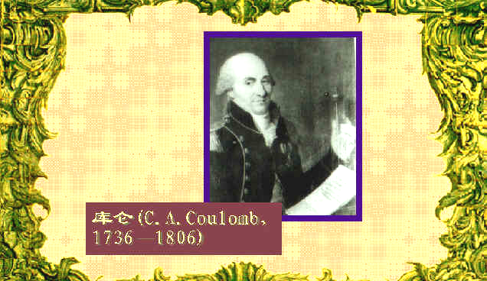
19-5. Coulomb's Law (P460-P464)

Slide 11
库仑——法国工程师、物理学家。1736年6月14 日生于法国昂古莱姆。1806年8月23日在巴黎逝世。
早年就读于美西也尔工程学校。离开学校后，进入皇家军事工程队当工程师。法国大革命时期，库仑辞去一切职务，到布卢瓦致力于科学研究。法皇执政统治期间，回到巴黎成为新建的研究院成员。
1773年发表有关材料强度的论文，所提出的计算物体上应力和应变分布情况的方法沿用到现在，是结构工程的理论基础。1777年开始研究静电和磁力问题。当时法国科学院悬赏征求改良航海指南针中的磁针问题。库仑认为磁针支架在轴上，必然会带来摩擦，提出用细头发丝或丝线悬挂磁针。研究中发现线扭转时的扭力和针转过的角度成比例关系，从而可利用这种装置测出静电力和磁力的大小，这导致他发明扭秤。1779年对摩擦力进行分析，提出有关润滑剂的科学理论。还设计出水下作业法，类似现代的沉箱。1785-1789年，用扭秤测量静电力和磁力，导出著名的库仑定律。

Slide 12
1. Point charge (点电荷) (p461)
当带电体的线度与它到其它带电体之间距离或到研究点之间的距离相比足够小时(d<<r), 可忽略其大小,将电荷看成集中于一点的带电体，称点电荷.
The sizes of objects are much more smaller than the distance between them.

Slide 13
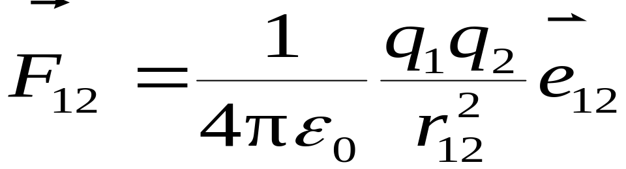
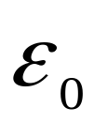
2. Coulomb’s Law
With the torsion balance (扭称实验)Coulomb established the Coulomb’s.
The force between two point charges at rest was inversely proportional to the square of the distance between them and proportional to the product of the charges.
（ 为真空电容率 permittivity of free space ）

Slide 14
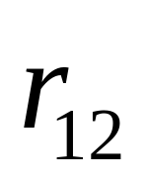
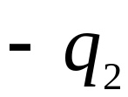

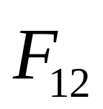
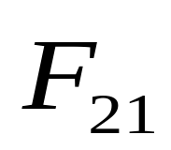


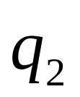
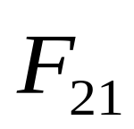
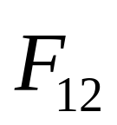
The direction of the electric force is always along the line joining the two objects. If the two charges have the same sign, the force on either object is directed away from the other. If the two charges have opposite signs, the force on one is directed toward the other.

Slide 15
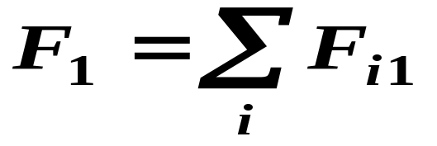
Description:
(1) It is an exp. Law, holds both for macroscopic & microscopic, only holds for “point charge” model.
(2) There are four basic physical quantities for electromagnetic quantity in the SI system. They are length (m), mass(kg), time(s), current(A).
(3) principle of superposition p462. The net force on any one of them will be the vector sum of the forces due to each of the others.
Vector sum

Slide 16
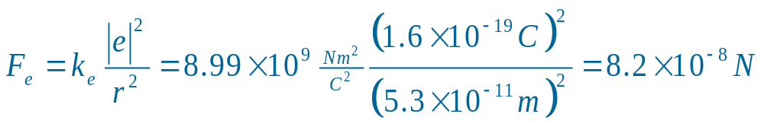
Example (p462): The electron and proton of a hydrogen atom are separated (on the average) by a distance of about 5.3x10⁻¹¹ m. Find the magnitude of the electric force that each particle exerts on the other.
Solution:
q₁ =-1.60x10⁻¹⁹ C, q₂ =1.60x10⁻¹⁹ C,
r = 5.3x10⁻¹¹ m
From Coulomb’s law

Slide 17
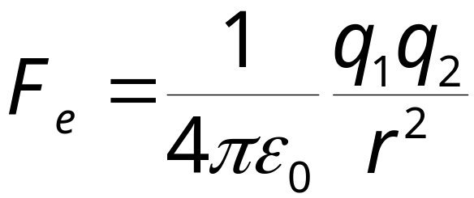
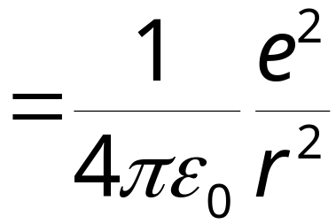
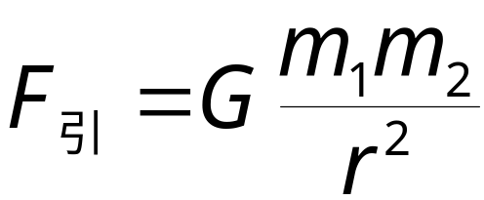
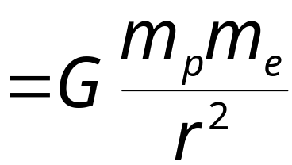
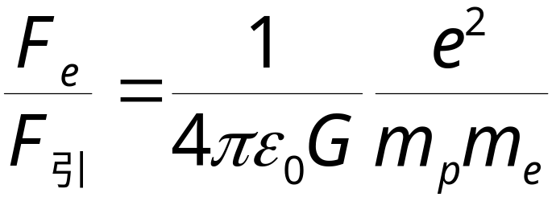

例：经典的氢原子中电子绕核旋转，质子质量 M_{p} = 1.67×10⁻²⁷ kg , 电子质量 m_{e}= 9.11×10⁻³¹ kg , 求电子与质子间的库仑力F_{e}与万有引力F_{引}之比。
解：库仑力大小
万有引力大小
（微观领域中,万有引力比库仑力小得多,可忽略不计.）

Slide 18
19-6&19-7&19-11 Electric Field (静电场)
(p464-471,476-477)
Coulomb’s interaction is at a distance. How does q₁ “know” of the presence of q₂? How the force of q₁ acts on the point charge q₂?
实验证实了两静止电荷间存在相互作用的静电力，
但其相互作用是怎样实现的？
电 场
电 荷
电 荷
场是一种特殊形态的物质
场
物 质
实物

Slide 19

1. The Basic Feature of Electric Field
♦ Giving an acting force to any charges in it (对放其内的任何电荷都有作用力) ;
♦ The electric force does work on moving charge (电场力对移动电荷作功) V ;

Slide 20


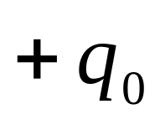
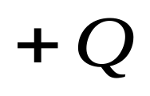
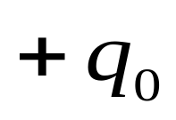
2. Definition of electric field (p464)
1)Test charge(试验电荷) q₀ (P464)
A charge so small that the force it exerts does not significantly alter the distribution of the charges that create the field being measured.
试验电荷为点电荷、且足够小,故对原电场几乎无影响.
场源电荷Q，场点处检验电荷q₀在电场中受力F。
q₀
F₀
2q₀
2F₀
3q₀
3F₀
…..
：场源电荷
…...
nq₀
nF₀
：试验电荷

Slide 21
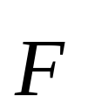

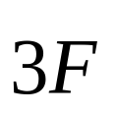



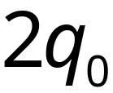
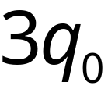
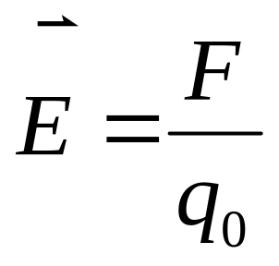
2) Definition of electric field:
The force exerted on a tiny positive test charge at that point divided by the magnitude of the test charge q.

Slide 22


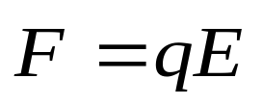
Discussion:
1) 是一个矢量.
2）电场中某点的电场强度与试验电荷的电量无关。
3）电荷 在电场中受的静电力

Slide 23
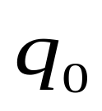

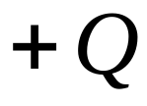


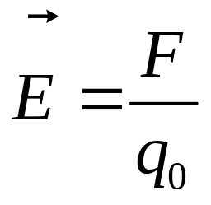
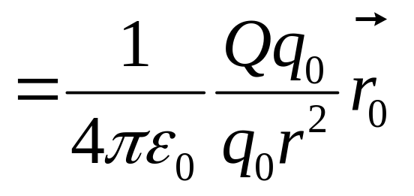
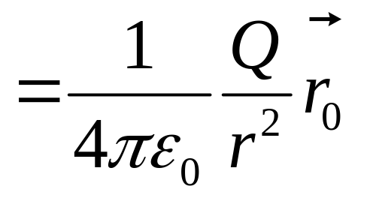
3. The Calculation of Electric Field (P465-P468)
1) Electric Field of A Single Point Charge: (点电荷的电场强度) p465
To find the electric field due to a point charge Q，we put a positive test charge q₀ at that point. From Coulomb’s law：

Slide 24
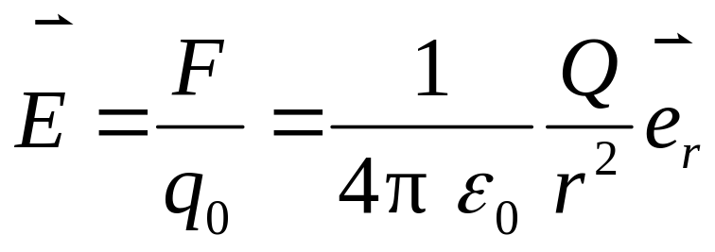


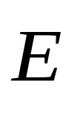

讨论
Q>0，
与 方向一致；
Q<0，
与 方向相反；

Slide 25
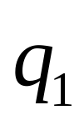


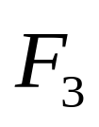





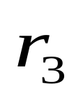
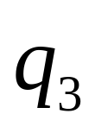


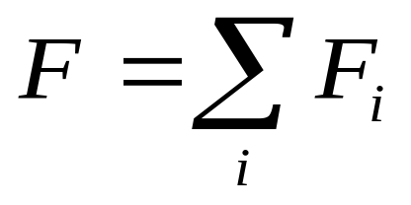
2) Superposition applies to electric fields （场强叠加原理）p466
To find the net electric field due to more than one point charge，we place a positive test charge q₀ near n point charges.
From the principle of superposition of :

Slide 26
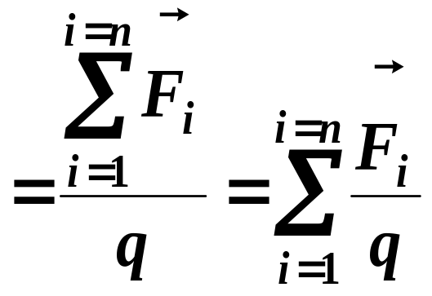
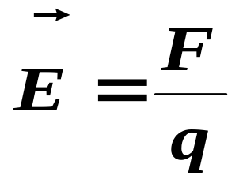
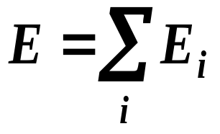
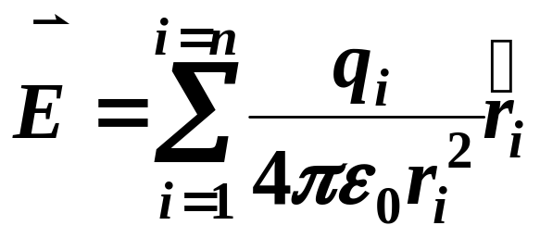

or
—— The Principle of superposition of
If there is a distribution of electric charges (whether they are discrete or continuous), the net electric field is the vector sum of that of all charges.
第一次课结束

Slide 27
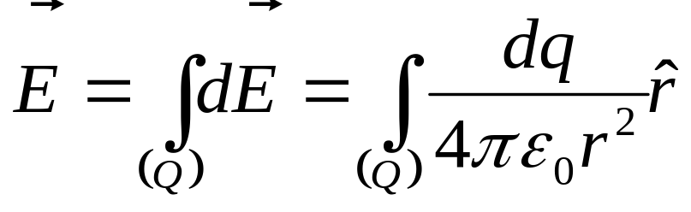
3) Electric Field Calculations for Any Continuous Charged Distributions (P468-471):
If the electric charge can be treated as being distributed continuously, we can divide up a charge distribution into infinitesimal charges dq, each of which will act as a tiny point charge.
把带电体看作是由许多个电荷元dq(可视为点电荷)组成,然后利用场强叠加原理。

Slide 28



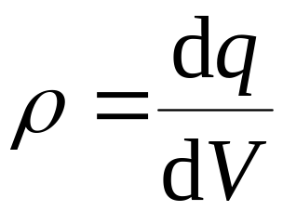
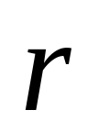
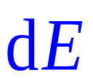
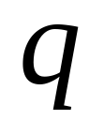

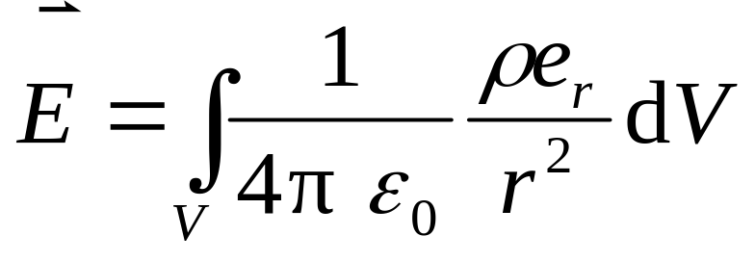

Density of Charge (DC):
电荷体密度
点 处电场强度

Slide 29
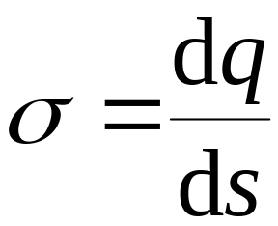







电荷面密度
电荷线密度

Slide 30




解题思路及应用举例
1.建立坐标系。
体密度ρ ,
面密度σ,
线密度λ
2.确定电荷密度:
3.求电荷元电量。
体dq= ρ dV,
面dq= σ dS,
线dq= λ dl。
4.确定电荷元的场
5.求场强分量E_{x}、E_{y}。
6 求总场

Slide 31



















例1: long line of charge：Determine the magnitude of the electric field at any point P a distance x from a very long line of uniformly distributed charge. 均匀带电直线长为2l，带电量q ,求中垂线上一点的电场强度。P469
SOLUTION:
The charge per unit length (线电荷密度)

Slide 32








Because of the symmetry (对称性), E_{y}=0

Slide 33







查积分表
讨论
1. l >>x ，无限长均匀带电直线，assume the wire is extremely long in both directions.
2. x>>l ，无穷远点场强，
相当于点电荷的电场。

Slide 34









例2 A ring of charge. A thin, ring-shaped object of radius a holds a total charge Q distributed uniformly around it. Determine the electric field at a point P on its axis, a distance x from the center. 正电荷 均匀分布在半径为 的圆环上.计算在环的轴线上任一点 的电场强度.p468-469

Slide 35








SOLUTION:
由对称性有

Slide 36






Slide 37











讨 论
（1）
（点电荷电场强度）
（2）
（3）

Slide 38








例3 均匀带电薄圆盘轴线上的电场强度.p470-480
有一半径为 ,电荷均匀分布的薄圆盘,其电荷面密度为 . 求通过盘心且垂直盘面的轴线上任意一点处的电场强度.
Uniformly charged disk. Charge is distributed uniformly over a thin circular disk of radius R₀. The charge per unit area is . Calculate the electric field at a point P on the axis of the disk.

Slide 39









SOLUTION:
解 由例2

Slide 40





Slide 41





讨 论
无限大均匀带电平面的电场强度
（点电荷电场强度）

Slide 42




Main Steps of Calculating Electric Field:
Step1:
Choose differential element of charge dq;
Step2:
Calculate set up by the dq ;
Step3:
Build up the coordinate system;
Resolving and find out the scalar integration for (将 分解,求标量积分).
Step4:
Determine the magnitude and direction of and discuss for its results.
Step5:
第二次课结束

Slide 43




19-8 Field lines p471-473
1. Electric field lines
A convenient way to visualize field patterns is to draw lines in the direction of the electric field. Such lines are called field lines.（形象地描述电场的大小和方向的一组有向曲线）

Slide 44


1) Field lines begin on positive charges and terminate on negative charges. Electric field vector , is tangent to the electric field lines at each point in space. （某点的电场方向是曲线在该点的切线方向，正→负电荷）
  2) The number of lines per unit area through a surface perpendicular to the lines is proportional to the strength of the electric field in a given region. E is large when the field lines are close together and small when far apart.
电力线密处场强大，电力线疏处场强小。

Slide 45




电场线密度：垂直于 的单位面积的电场线的数目，大小等于 .

Slide 46
点电荷的电场线
a positive point charge
a negative point charge
+

Slide 47
Two charges of opposite sign
+

Slide 48
Two equal positive charge
+
+

Slide 49


Unequal charges, +2q and -q

Slide 50

Two oppositely charged parallel plates
+ + + + + + + + + + + +

Slide 51
2. Rules for drawing electric field lines for any charge distribution.
  1) Lines must begin on positive charges (or at infinity) and must terminate on negative charges or in the case of excess charge at infinity. 起于正电荷（或“∞”远），止于负电荷（或“∞”远）
电场线始于正电荷，终止于负电荷，不会在无电荷处中断，电场线为非闭合曲线。

Slide 52


  2）The number of lines drawn leaving a positive charge or approaching a negative charge is proportional to the magnitude of the charge. 电场线的多少与电荷量有关
  3）No two field lines can cross each other.在没有电荷任何两条电场线不能相交
×

Slide 53




19-9.Electric Fields and Conductors P473-474
1.静电平衡 Static situation
导体内部无宏观电荷的定向移动，导体处在静电平衡状态。
+
+
+
+
+
+
+
+

Slide 54

1) 导体内部任意一点的场强为0.
The electric field inside a conductor is zero.
导体内电场强度
外电场强度
感应电荷电场强度
If there were an electric field within a conductor, there would be a force on its free electrons. Then they would move.

Slide 55

2) 静电平衡时，场强方向与导体表面垂直。
The electric field is always perpendicular to the surface outside of a conductor.
If the electric field at the surface of a conductor had a component parallel to the surface, the electrons would move.
如果场强不垂直于表面，电场力继续移动电荷，不满足静电平衡条件。

Slide 56


2 静电屏蔽 Electrostatic Shielding
1)屏蔽外电场
外电场
空腔导体屏蔽外电场
空腔导体可以屏蔽外电场, 使空腔内物体不受外电场影响.这时,整个空腔导体和腔内的电势也必处处相等.

Slide 57



2)屏蔽腔内电场
接地空腔导体
将使外部空间不受
空腔内的电场影响.
+
+
+
+
+
+
+
+

